Slide 1
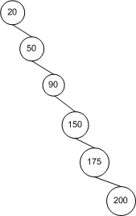
Self-balancing Binary Search Trees (and the process of keeping it balanced)
Kurt Friedrich
Spring 2015
(Avoiding these unlucky cases)
https://msdn.microsoft.com/en-us/library/ms379573(v=vs.80).aspx

Slide 2
Self-balancing BSTs
A binary tree is a special kind of tree, one that limits each node to no more than two children.
A binary search tree, or BST, is a binary tree whose nodes are arranged such that for every node n, all of the nodes in n's left subtree have a value less than n, and all nodes in n's right subtree have a value greater than n.
In the average case BSTs offer log₂ n asymptotic time for inserts, deletes, and searches.
The disadvantage of BSTs is that in the worst-case their running time can approach linear time.
This happens if the items inserted into the BST are inserted in order or in near-order. In such a case, a BST performs no better than an array.
Self-balancing BSTs ensure that, regardless of the order of the data inserted, the tree maintains a log₂ n running time.

Slide 3
Height of a BST
BSTs perform well when their nodes are arranged in a fanned out manner. This is because when searching for a node in a BST, each single step down the tree reduces the number of nodes that need to be potentially checked by one half. (which is log₂ n )
The running time of a BST's operations is related to the BST's height. The height of a tree is defined as the length of the longest path starting at the root. The height of a tree can be defined recursively as follows:
The height of a node with no children is 0.
The height of a node with one child is the height of that child plus one.
The height of a node with two children is one plus the greater height of the two children.

Slide 4
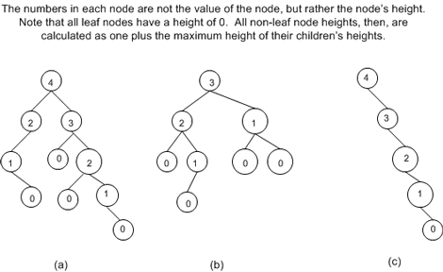
To compute the height of a tree, start at its leaf nodes and assign them a height of 0. Then move up the tree using the three rules outlined to compute the height of each leaf nodes' parent. Continue in this manner until every node of the tree has been labeled.
The height of the tree, then, is the height of the root node.

Slide 5
Short fat trees.
A BST exhibits log₂ n running times when its height, when defined in terms of the number of nodes, n, in the tree, is near the floor of log₂ n.
The floor of a number x is the greatest integer less than x. So, the floor of 5.38 would be 5 and the floor of 3.14159 would be 3. (For positive numbers x, the floor of x can be found by simply truncating the decimal part of x, if any.)
Tree (c) has the worst height to node ratio. With its 5 nodes it could have an optimal height of 2, but due to its linear topology is has a height of 4.
A better BST would “build itself” making sure that the topology of the resulting BST exhibits an optimal ratio of height to the number of nodes. (short fat trees!)
Since we can clearly not guarantee the data is not inserted in near-sorted order, we need a solution that does not to try to dictate the order with which the data is inserted, but instead somehow after each insertion the BST remains balanced.

Slide 6
balanced trees
A balanced tree is a tree that maintains some predefined ratio between its height and breadth.
Different data structures define their own ratios for balance, but all have it close to log₂ n.
There are numerous self-balancing BST data structures in existence, such as AVL trees, red-black trees, 2-3 trees, 2-3-4 trees, splay trees, B-trees, and others.
We'll take a brief look at two of these self-balancing trees—AVL trees and red-black trees.

Slide 7
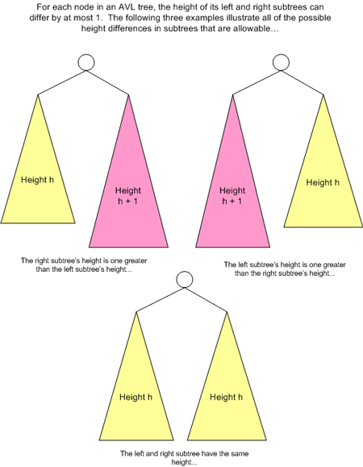
In 1962 Russian mathematicians G. M. Andel'son-Vel-skii and E. M. Landis invented the first self-balancing BST, called an AVL tree.
As nodes are added or deleted, the balance property remains. AVL trees maintain the balance through rotations. A rotation slightly reshapes the tree's topology such that the AVL balance property is restored and, just as importantly, the binary search tree property is maintained.

Slide 8
Inserting a new node into an AVL tree is a two-stage process.
1st, the node is inserted into the tree using the same algorithm for adding a new node to a BST.
That is, the new node is added as a leaf node in the appropriate location to maintain the BST property.
After adding a new node, it might be the case that adding this new node caused the AVL balance property to be violated at some node along the path traveled down from the root to where the newly inserted node was added.
To fix any violations, stage 2 involves traversing back up the access path, checking the height of the left and right subtrees for each node along this return path. If the heights of the subtrees differs by more than 1, a rotation is performed to fix the anomaly.
The following images illustrates the steps for a rotation on node 3.
Notice that after stage 1 of the insertion routine, the AVL tree property was violated at node 5, because node 5's left subtree's height was two greater than its right subtree's height.
To remedy this, a rotation was performed on node 3, the root of node 5's left subtree. This rotation fixed the balance inconsistency and also maintained the BST property.

Slide 9
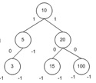
Starting with a balanced tree;
Now insert a node with key of 2
2

Slide 10
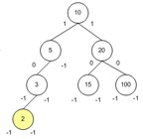
Stage 1 is to just insert it as a normal BST;
But notice that the sides are no longer balanced, right is height 2 while left is height 3
Stage 2 starts by walking back up the path that was used to do the insertion, and updating the left and right subtree heights, and then doing a rotation if necessary.
(In the diagram the left and right subtree heights have not yet been updated, see next slide.)

Slide 11
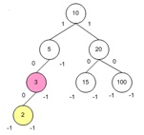
We start at the node just above the new one, and update its subtree heights (from -1 -1 to 0 -1)
Since the difference between 0 and -1 is only one, no change is required.

Slide 12
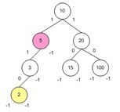
Now we go back up one more node, to node 5 and update its subtree heights (from 0 -1 to 1 -1)
Since the difference between 1 and -1 is greater than 1, a rotation is required.
This is done on the node below it, 3

Slide 13
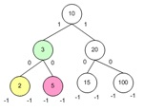
A rotation of 3 gets us to this situation.
The tree is now consistent with both the requirements for BSTs and AVLs.
How to visualize a rotation:
You grab the node to be rotated and shake it violently, gravity will cause the 5 node above it to fall down under the 3 node as its new right node, and 3 takes 5’s place as the left node of node 10.
It turns out, when you insert 1 node you never have to rotate more than 1 node, so we know we are done.

Slide 14
There are more complicated rotations …
In addition to this simple, single rotation we just did, there are more involved rotations than are sometimes required.
But a thorough discussion of the set of rotations potentially needed by an AVL tree is beyond the scope of this class.
But it is important to realize is that both insertions and deletions can disturb the balance property to which that AVL trees must adhere. In which case, a rotation will be needed.
You can see an AVL visualization at http://www.cs.usfca.edu/~galles/visualization/AVLtree.html try inserting 1 2 3 4 5 6 which would normally be very bad for a BST

Slide 15
red-black trees
Was invented in 1972 by Rudolf Bayer, a computer science professor at the Technical University of Munich.
In addition to its data and left and right children, the nodes of a red-black tree contain an extra bit of information. This could have been called up/down, yes/now, or whatever, but he called it a color, which can be either, red or black. (just a name for bit on, bit off)
Red-black trees are complicated further by the addition of a special type of node referred to as NIL nodes. NIL nodes are pseudo-nodes that exist as the leaves of the red-black tree.
That is, all regular nodes—those with some data associated with them—are internal nodes. Rather than having a NULL pointer for a childless regular node, the node is assumed to have a NIL node in place of that NULL value. See the diagram next.

Slide 16
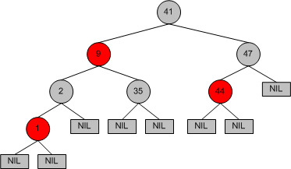
red-black trees have four properties:
Every node is colored either red or black.
If a node is red, then both of its children are black.
Every NIL node is black.
Every path from a node to a descendant leaf contains the same number of black nodes.

Slide 17
The fourth property
States that starting from any node in the tree, the number of black nodes from that node to any leaf node (which are defined to be the NIL nodes), must be the same. See next diagram.
Any time a red-black tree has nodes inserted or deleted, it must be done in a way that the red-black tree properties are not been violated. With red-black trees, the red-black tree properties are restored through recoloring and rotations.
Red-black trees are notoriously complex in their recoloring and rotation rules, requiring the nodes along the access path to make decisions based upon their color in contrast to the color of their parents and uncles. (An uncle of a node n is the node that is n's parent's sibling node.) The rules for recoloring and rotation are far beyond the scope of this class.
Visualization http://www.cs.usfca.edu/~galles/visualization/RedBlack.html click on show null nodes, and slow animation way down!

Slide 18
Look at the root node. Starting from 41 and going to any NIL, you will encounter the same number of black nodes—3. For example, taking a path from 41 to the left-most NIL node, we start on 41, a black node. We then travel down to node 9, then node 2, which is also black, then node 1, and finally the left-most NIL node. In this journey we encountered three black nodes—41, 2, and the final NIL node. If you travel from 41 to any NIL node, we'll always encounter precisely three black nodes.

